Slide 1



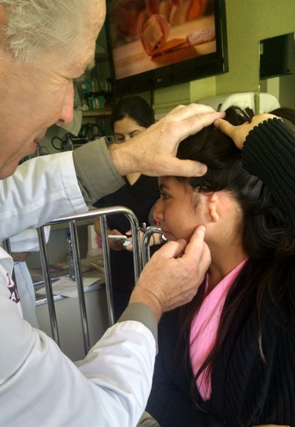
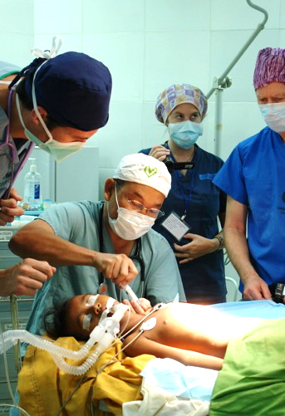
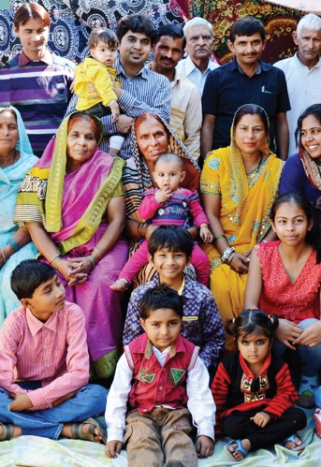

Our
Story
TREAT
TRAIN
TRANSFORM

Slide 2


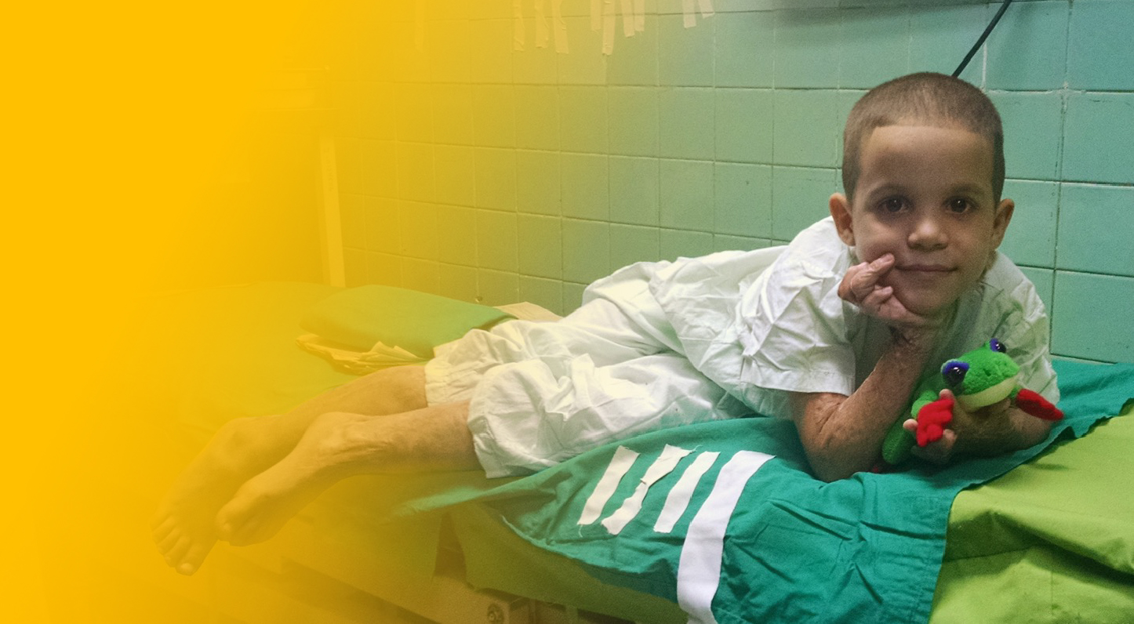
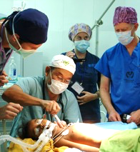
Our Mission
Founded in 1999 by renowned plastic surgeon Dr. Larry Nichter, Mission Plasticos is a 501c3 non-profit organization dedicated to providing reconstructive surgical care to those in need, and to generate sustainable outcomes through medical team training, public education and research.
Treat. Train. Transform.

Slide 3
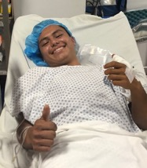
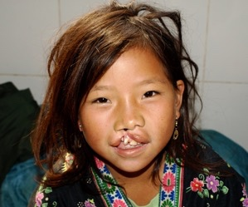
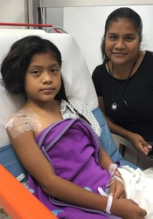
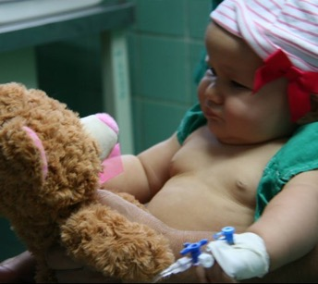
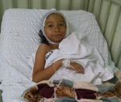
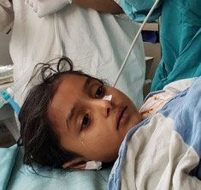
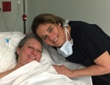
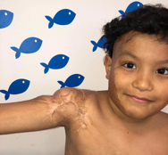
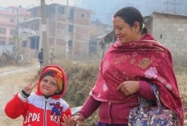
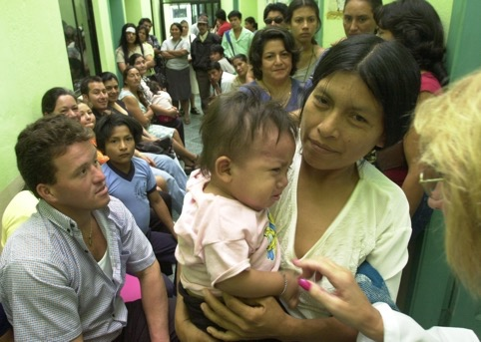
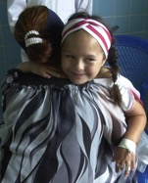
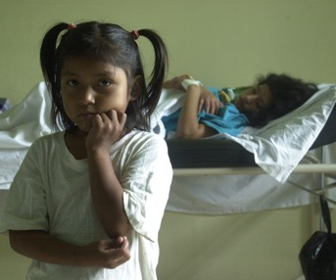
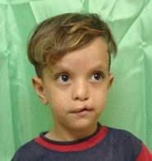
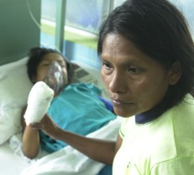
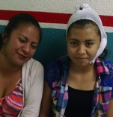
Who We Help
We focus on those in need of reconstructive surgery in medically underserved communities, both locally and globally.

Slide 4
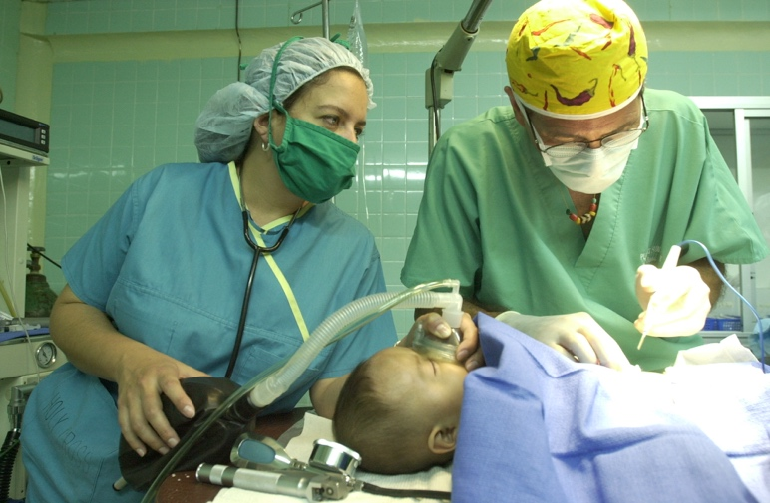
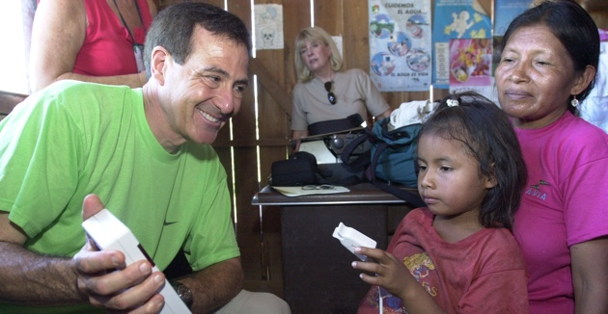
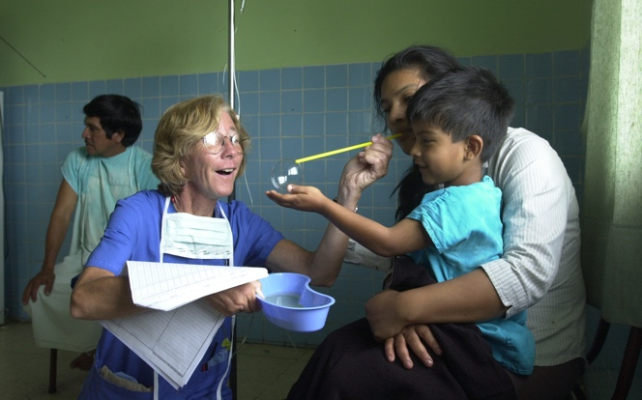
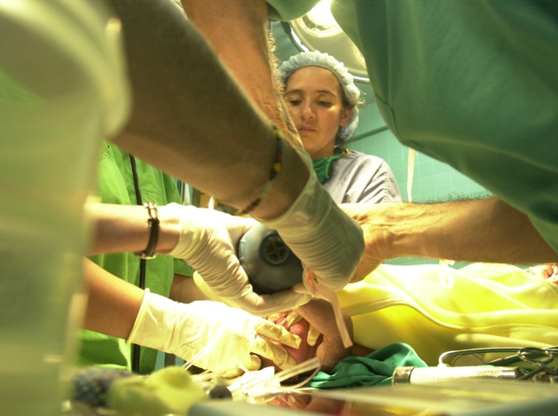
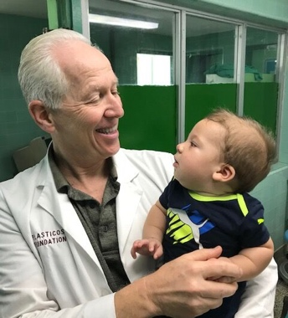
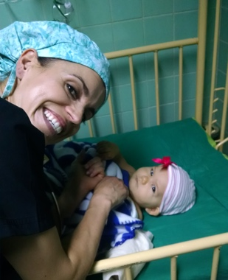
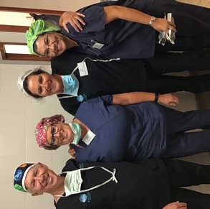
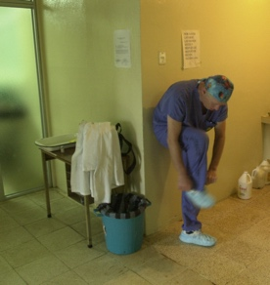
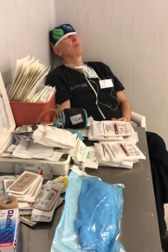
How We Make It Happen
Our volunteer team of leading surgeons and medical professionals dedicate their time, talent, and care to transform lives globally by providing reconstructive surgery, training local medical professionals, and supporting ongoing research focused on improving standards of care.

Slide 5

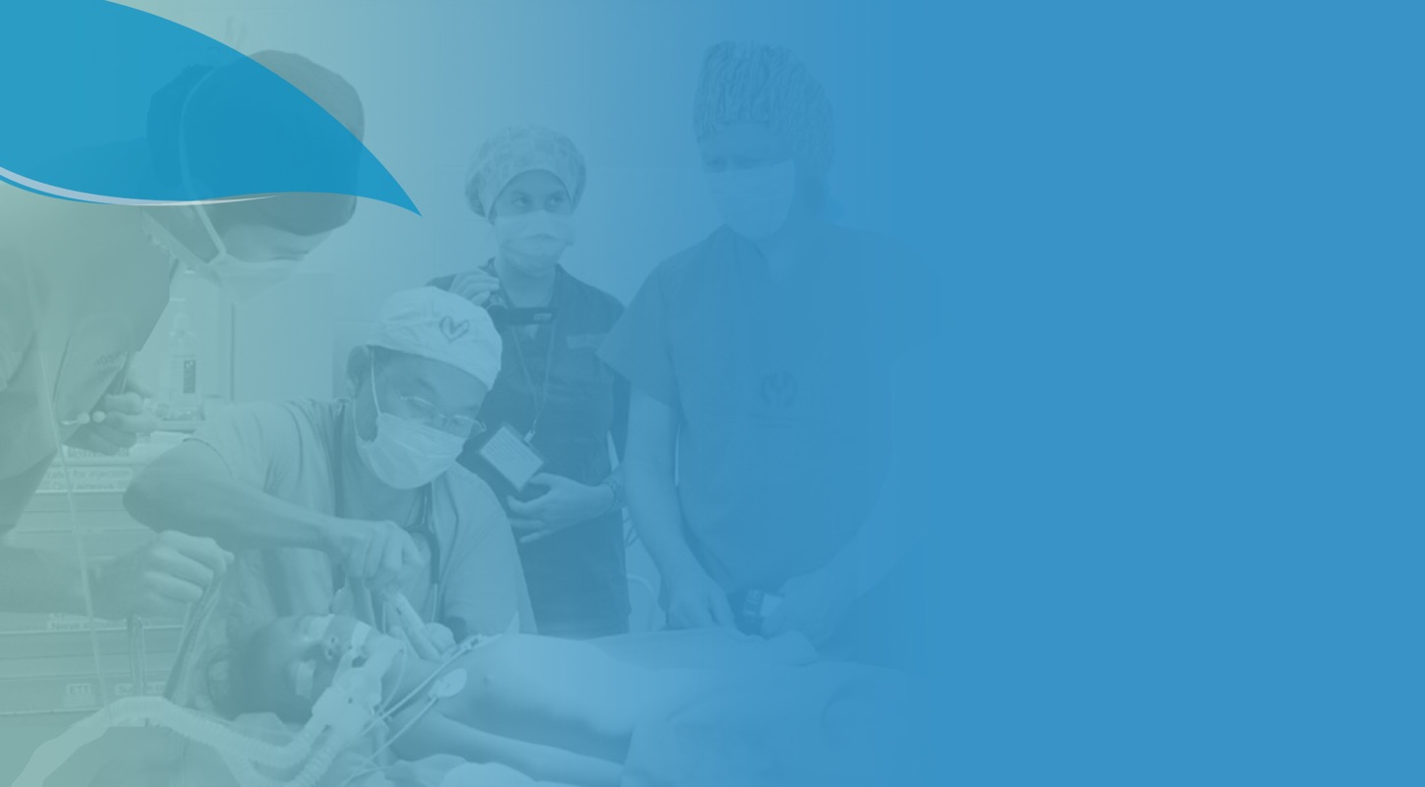






What We Treat
Acute
Burns
Burn Scar
Contractures
Cleft Lip and Palate
Complex traumatic injuries, acute burns, and disfigurement as a result of burn scar contractures, cancer and congenital deformities.
Hand Deformities and Injuries
Ear Deformities
Post-Mastectomy
Breast
Reconstruction

Slide 6
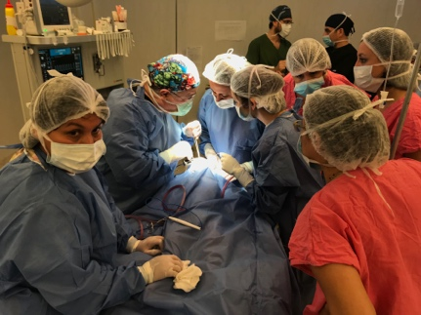
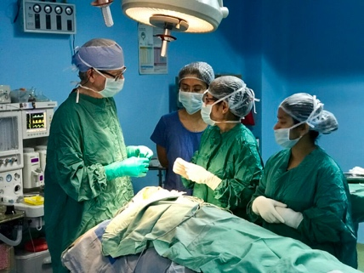
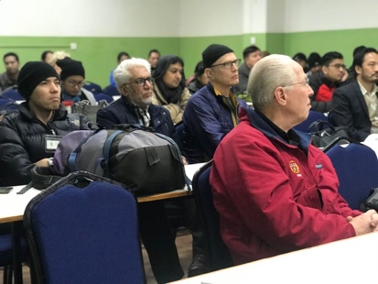
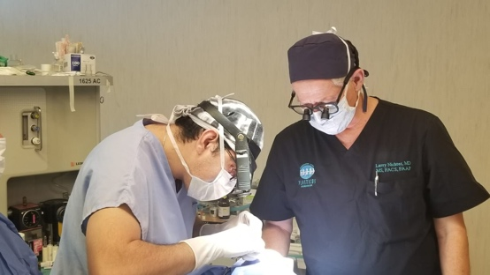
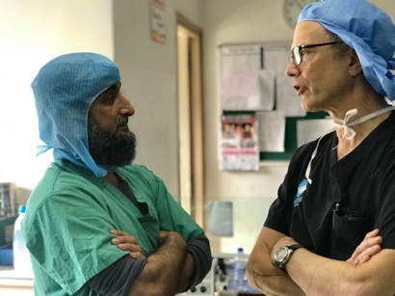
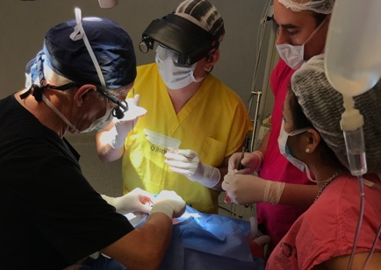
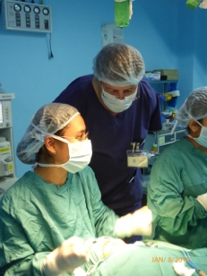
How We Train
Mission Plasticos is equipping and empowering local health care teams to transform lives In their local communities, ensuring sustainable and optimal outcomes.
We offer:
Hands-on advanced
surgical training
Education on best practices
Follow-up visits
Annual oversight and
prevention strategies

Slide 7

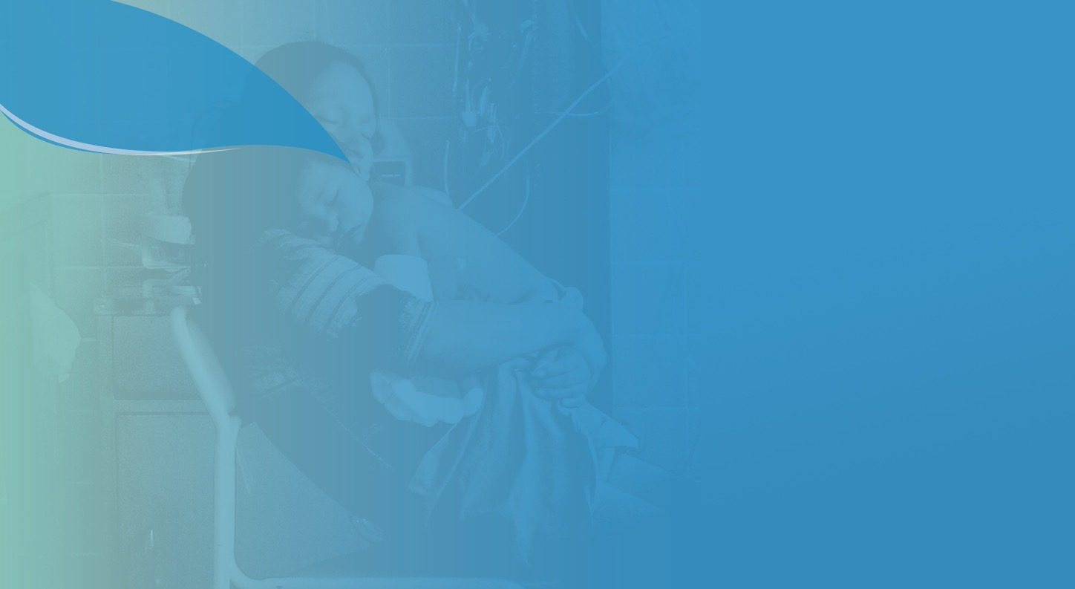





100+
MISSIONS
COMPLETED
650
~
MEDICAL
VOLUNTEERS
5,000+
DOCTORS
TRAINED
The Plasticos Effect:
A Legacy of
Transformation
16,000+
PATIENTS
TREATED
COUNTLESS LIVES AND
COMMUNITIES TRANSFORMED

Slide 8


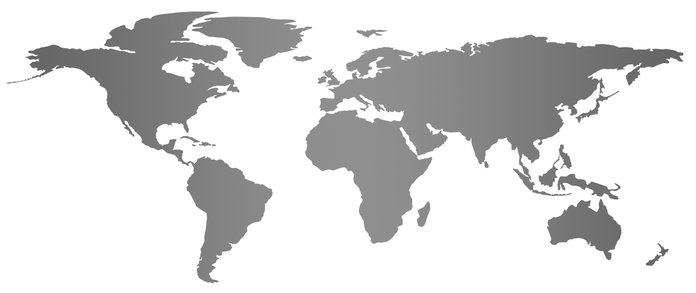

Our Global Reach
We partner with hospitals and doctors in the United States, and around the globe to treat, train and transform lives. We continue to expand our footprint based on the most pressing needs and, to date, have conducted missions in Argentina, Armenia, Afghanistan, Bolivia, Brazil, Cambodia, Cuba, Ecuador, Guatemala, India, Laos, Mexico, Nepal, Nicaragua, the United States, and Vietnam.

Slide 9

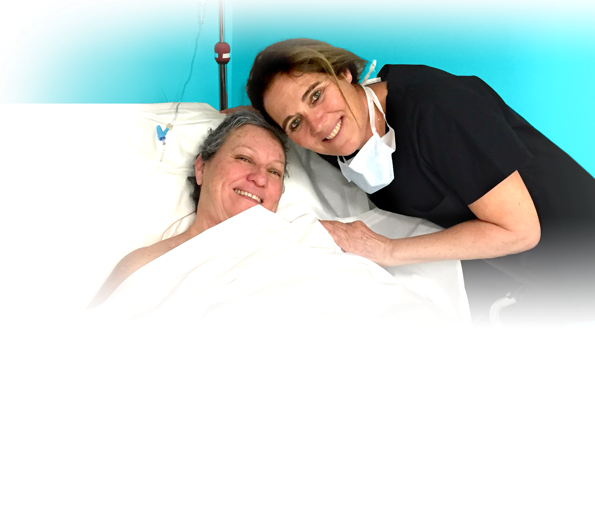

Kareen, cancer survivor and breast reconstruction patient, with Dr. Isabelle Schaison, Founder of Reshaping Lives California
Mission Plasticos’ domestic program Reshaping Lives America provides
no-cost burn contracture surgery, post traumatic and congenital deformities, and other reconstructive surgical care to people living in poverty in the United States. It is based on our southern California pilot program Reshaping Lives California, which has already helped over 1,000 local patients in need.
Reshaping Lives America’s breast reconstruction program Reshaping Lives: Full Circle is a partnership between Mission Plasticos and Sientra, a medical aesthetics company uniquely focused on plastic surgery. This program provides patients in need with breast reconstructive surgery performed by board-certified volunteer surgeons in their area.

Slide 10


60%
A partnership between Sientra and Mission Plasticos, Reshaping Lives: Full Circle is the first large-scale nationwide program providing no-cost breast reconstruction surgery for post-mastectomy women in the U.S. who are uninsured or underinsured.
Mission Plasticos provides this care using volunteer board-certified plastic surgeons across the country who are experts in breast reconstruction, with Sientra donating all necessary breast implants and tissue expanders. Once patients are identified at the local level, Mission Plasticos thoroughly vets each and coordinates their full journey of care.
Part of Mission Plasticos’ broader Reshaping Lives America program, Reshaping Lives: Full Circle is based on the success of Mission Plasticos’ global work over the last 23 years and their pioneering domestic work in California since 2016.
of U.S. women with breast cancer who live below the poverty line are inadequately insured and may not have access to breast reconstructive surgery¹ despite reconstruction being considered the standard of care in breast cancer recovery².
Every woman deserves
A full journey of care
regardless of her economic situation.
1. Gorey, K. M., Richter, N. L., Luginaah, I. N., Hamm, C., Holowaty, E. J., Zou, G., & Balagurusamy, M. K. (2015). Breast cancer among women living in poverty:
Better care in Canada than in the United States. Social Work Research, 39(2), 107–118. https://doi.org/10.1093/swr/svv006. 2. “Women’s Health and Cancer Rights Act (Whcra).” CMS, www.cms.gov/CCIIO/Programs-and-Initiatives/Other-Insurance-Protections/whcra_factsheet.

Slide 11
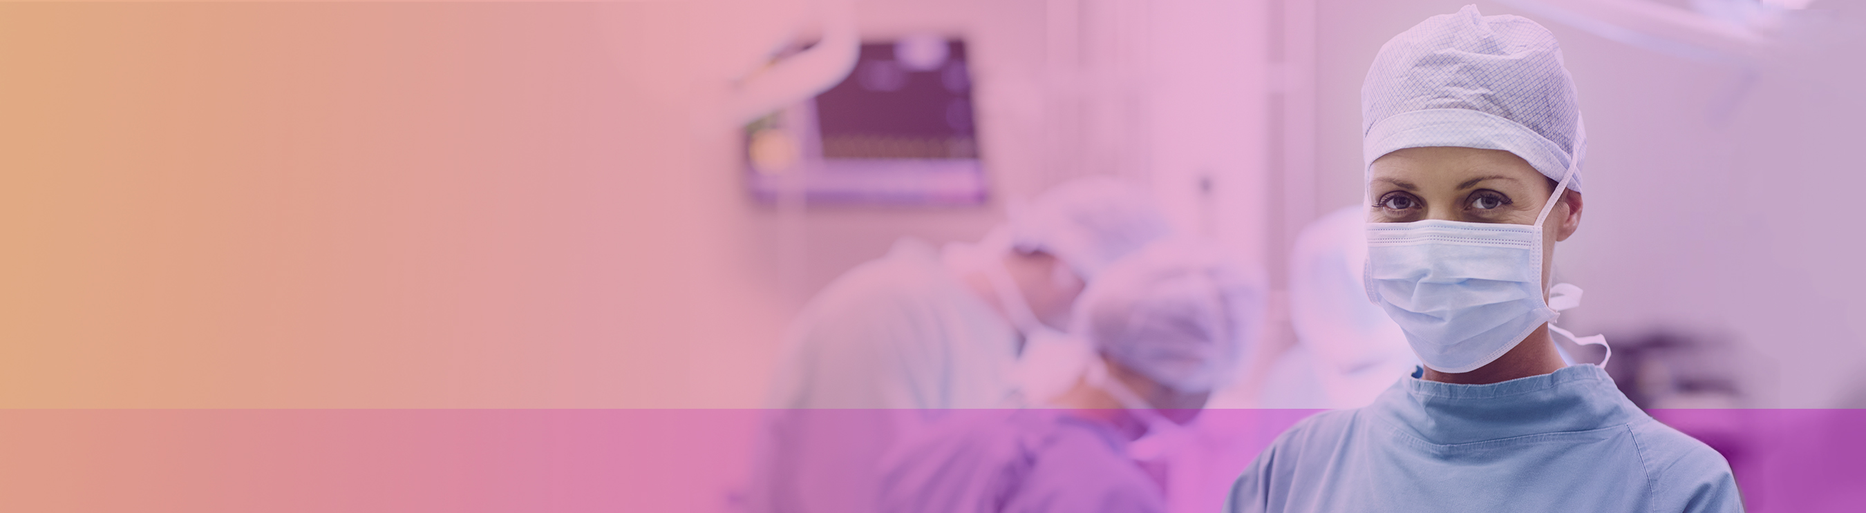
Surgeon Recruitment
Contact us if you are a board-certified surgeon interested in volunteering for our life-changing program providing no-cost breast reconstructive surgery to post-mastectomy women in the U.S. living in poverty.
SURGEON COMMITMENT
By signing up for the Reshaping Lives: Full Circle program, surgeons are committing to performing at least one Reshaping Lives: Full Circle breast reconstruction surgery during the 2023 calendar year.
Reshaping Lives: Full Circle will help identify patients in need in the surgeon’s area and supply Sientra implants and expanders for each surgery.
All other costs including staff and surgery center fees will be arranged and covered at the surgeon’s expense.
All volunteer work is tax-deductible. Mission Plasticos will process the paperwork and supply a letter for the surgeon’s in-kind gift.
RESHAPING LIVES: FULL CIRCLE APPRECIATION
We will promote each surgeon’s program involvement with a listing on our dedicated surgeons page on the Reshaping Lives: Full Circle website.
The surgeon and practice will also be highlighted in the Featured Surgeon section on the home page and promoted through social media
Surgeons will also receive a commemorative Reshaping Lives: Full Circle scrub cap and a special program badge to add to their practice website.
Most importantly, surgeons gain the opportunity to differentiate themselves and their practice by helping those in need and giving back to their community.

Slide 12
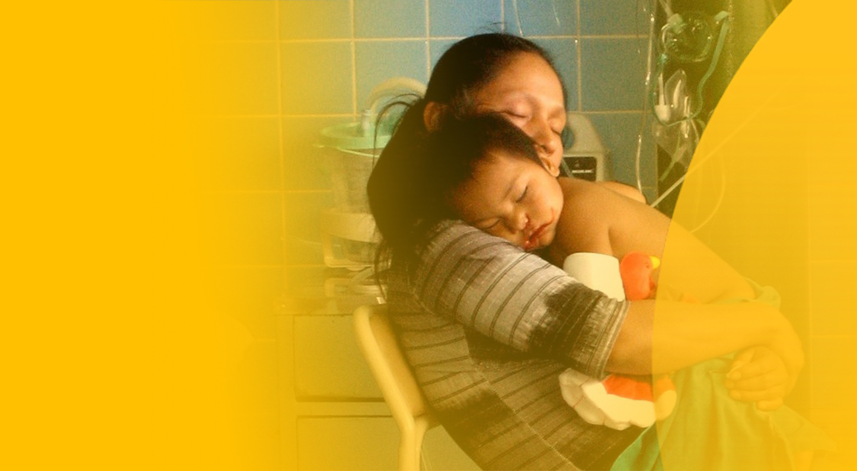
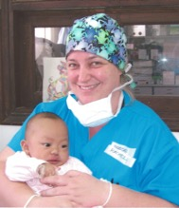
Global Impact
Mission Plasticos’ volunteer teams travel year-round to poverty-stricken regions to perform life-changing reconstructive surgeries and training that empower health care professionals around the globe.
“I was told that this would be a life changing experience, but I was unable to grasp the reality of the situation prior to arrival. Cold hallways, hopeful faces, sad tears, gentle touches, and life and death surrounded me. The patients were genuinely thankful for the care they were receiving, and the local team continued to do their very best with all odds against them. Together, we can overcome challenges and provide hope and support for those who need it most, whether home or abroad.”
— Olyvia Weston, Global Volunteer

Slide 13
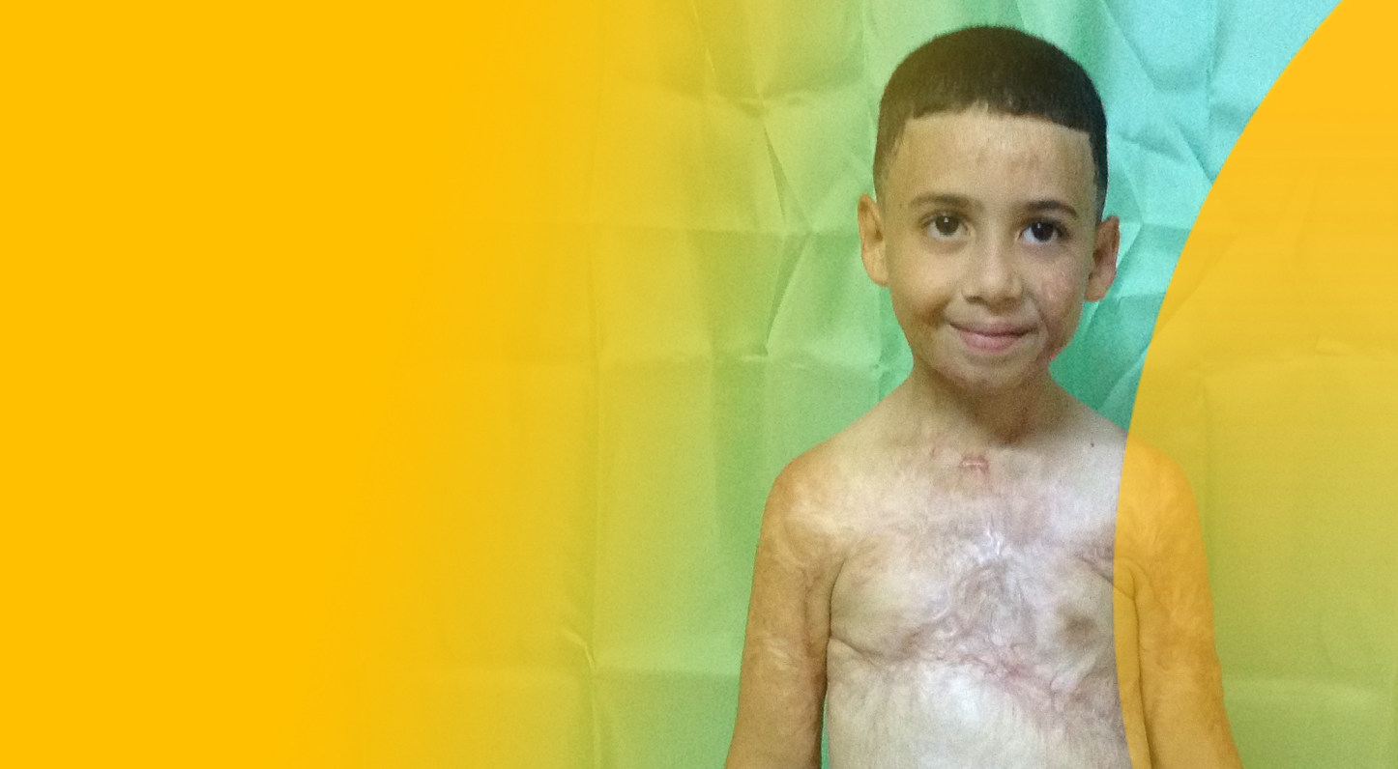
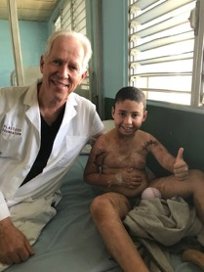
Transforming lives via our
Acute Burn Program
Mission Plasticos has made history for being the first NPO to train others in optimal burn management in developing countries.
The Mission Plasticos team is proud to take on this important mission given the great need in medically underserved communities.
“In the presence of patients with severe burns in a hospital with very limited resources, the heroes are the brave doctors and warrior nurses. From surgeons and anesthesiologists I learned that indomitable character is the most valuable way to deal with this catastrophe, in performing life-saving surgeries typical of war situations.”
— Dr. Gary Fudem
Notes:
The Mission Plasticos team provides advanced acute burn care and training – including hands-on surgical experience, lectures and follow-up visits – to burn surgeons, plastic surgeons, anesthesiologists, respiratory therapists, occupational therapists, and critical care nurses across the globe.
Comprehensive burn treatment and education program at Kirtipur Hospital in Kathmandu, Nepal multi-pronged approach:
Determine major causes of burn injuries in Nepal and recommend solutions
Introduce advanced surgical techniques for the acute burn treatment that prevent contractures, disfigurement and disability
Educate regarding the importance of nutrition, hygiene, physical therapy and psychological therapy for survival and optimal healing and rehabilitation on all levels
Provide annual oversight and training visits to promote implementation of best practices and needs assessment going forward.
Conduct ongoing analysis of burn prevention strategies

Slide 14

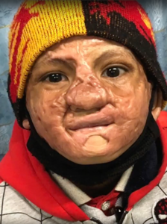
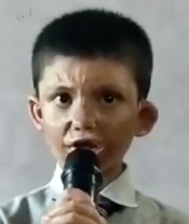
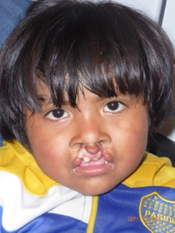
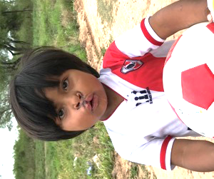
Abiskar
Nepal
Acute Burns
Personal
Impact
BEFORE
AFTER
Jose Victor
Argentina
Cleft Lip and Palate
BEFORE
AFTER

Slide 15
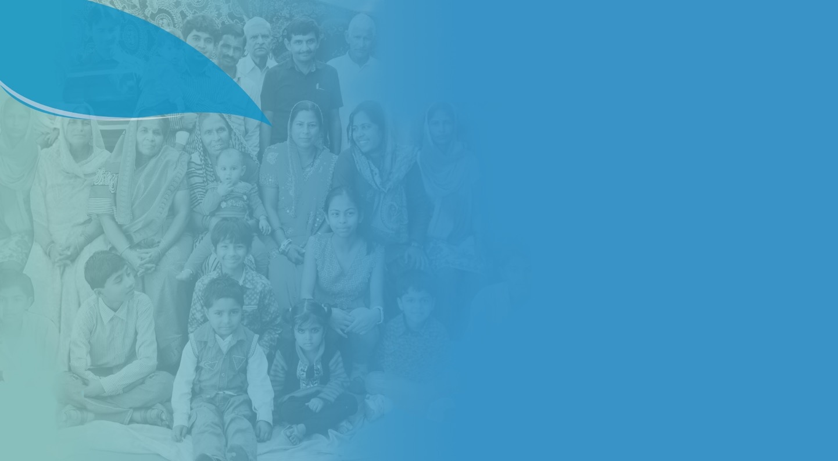



How You Can Help
Requests for assistance from global partners and local agencies have increased in volume and urgency.
Mission Plasticos is 100% privately funded and our ability to transform lives is directly proportionate to donations received.

Slide 16

Every Donation Matters
$50,000
Treat 100+ patients
Train 20+ doctors and nurses through hands-on experiences and symposia
Transform lives and a community
$10,000
Treat 10+ patients
Train 10+ doctors and nurses through hands-on experiences
Transform lives
$25,000
Treat 20+ patients
Train 10+ doctors and nurses through hands-on experiences and symposia
Transform lives
$5,000
Treat 5+ patients
Train 5+ doctors and nurses through hands-on experiences
Transform lives

Slide 17





Council of Trustees
Sientra, a medical aesthetics company uniquely focused on plastic surgery, is the founding trustee of Reshaping Lives America. Sientra President and Chief Executive Officer Ron Menezes serves as the Chairman of the newly formed Reshaping Lives America Council of Trustees, the funding arm of the program. The Council of Trustees provides Mission Plasticos with operational support and guidance on U.S. expansion and policy matters pertaining to providing access to reconstructive surgical care for U.S. patients in need.
Join the Reshaping Lives America Council of Trustees to help Ron and Mission Plasticos grow this amazing program into a nationwide movement.
“
Sientra is proud to support the Mission Plasticos Reshaping Lives America program. Connecting patients in need with outstanding board-certified reconstructive surgeons will make a significant difference in the lives of not only patients, but also their families and communities.
”
Ron Menezes
Reshaping Lives America Council of Trustees Chair, Sientra CEO
“
I am looking forward to collaborating with Mission Plasticos for the Reshaping Lives America program as they work to connect board certified surgeons who want to make a difference in their community to those who will most benefit from their expertise.
”
Arash Khazei
Reshaping Lives America Council of Trustees Member, miraDry CEO
“
I am honored to be a part of Mission Plasticos Reshaping America, a non-profit organization that understands that the road to breast cancer recovery does not end with a mastectomy. It ends with making the survivor whole, both physically and emotionally.
”
N. Bill Aydin, MD, FACS
Reshaping Lives America Council of Trustees Member , Double Board-Certified Plastic Surgeon at Aydin Center for Plastic Surgery
“
I feel it is important to volunteer my time and effort to this meaningful cause that helps individuals in need, as well as the community as a whole.
”
Joe Yaccarino
Reshaping Lives America Council of Trustees Member, MTF Biologics President and Chief Executive Officer

Slide 18









Board of Directors
Staff
Anne Andrews, JD
  Board Chair
Andrews & Thornton, Managing Partner
Scott Burell
Treasurer
AIVITA Biomedical, Inc., Chief Financial Officer and Corporate Secretary
Hans Keirstead, PhD
  Immediate Past Board Chair
  AIVITA Biomedical, Inc., Chief Executive Officer
Gregory R.D. Evans, MD, FACS
Board Member
Professor of Plastic Surgery and Biomedical Engineering | Founding Chair Department of Plastic Surgery | The Bruce F. Connell Endowed Chair in Plastic Surgery | The University of California, Irvine | Past President American Society Plastic Surgeons
Susan Williamson
  Executive Director
Larry Nichter, MD, FACS, FAAP
  Founder and Medical Director
  Pacific Center Plastic Surgery Co-owner,
  BioSpa Medical Co-owner
Megan Seltzer
  Director of Events & Community Outreach
Caroline Van Hove
  Secretary
Revelle Aesthetics, President, Chief Executive Officer
Adriana Murillo
  Program Director
Susan Williamson
  Executive Director

Slide 19
Advisory Council
Business Advisory Council
José Bimont
Johnson & Johnson
WW Vice President Digital,
CRM and Ecommerce
Fairyal Day
Med Talent Finder
Manager Director
Gloria M Janata, JD
TogoRun, President & CEO
Don Maree
President of AlumierMD USA
& President of the Alumier
Foundation USA
Tom Seery
Real Self, CEO
Medical Advisory Council
John H. Barker, MD
Friedrichsheim Foundation Professor of Experimental Trauma & Orthopedic surgery Director, Frankfurt Initiative for Regenerative Medicine, J.W. Goethe-Universität Frankfurt, Germany
Ernesto Cofiño, MD
Angeles de la Tierra President
Guatemala City, Guatemala
Gary Fudem, MD, FACS
Professor of Surgery, Plastic Surgery and Burns, University of Massachusetts and University of Washington
Holly Hurless, MSN, RN
Director of Nursing, Mission Plasticos
Karen Leong, MD
Reshaping Lives America Lead Surgeon
Isabelle Schaison, PhD
Reshaping Lives California Founder
Sam Sharar, MD
Mission Plasticos Anesthesia Critical Care and ICU Professor, Vice-Chair for Faculty Affairs and Development Associate Medical Director, King County Medic One Department of Anesthesiology and Pain Medicine University of Washington School of Medicine Harborview Medical Center
Stephen Westerhout, MD
Director of Anesthesiology
Board Emeritus
Robert Burns, MD, PhD
General and Vascular Surgeon, Emeritus Chair
Ruth Ann Burns
Friends of Plasticos, Chair
Tim Glassett, JD
General Counsel
Jed H. Horowitz, MD, FACS
Pacific Center Plastic Surgery Co-owner & BioSpa Medical Co-owner
Rachel Russell
Hoag Hospital, Cardiothoracic Surgery
Philippe Schaison
Soltego, CEO
Sol Khazani
  U.S. Auto Parts Network, Inc., Co-founder, American Condenser, Inc., Co-founder, Kool Vue, Founder
Nella Webster O’Grady
  Ocean Heights Advisors, Managing Director

Slide 20

Thank You!
Mission Plasticos, a California non-profit corporation.
8502 E. Chapman Ave. #447, Orange, CA 92869 www.missionplasticos.org
Plasticos Foundation is a tax-exempt 501(c)(3) organization. Tax ID#: 33-0831358.

