Slide 1
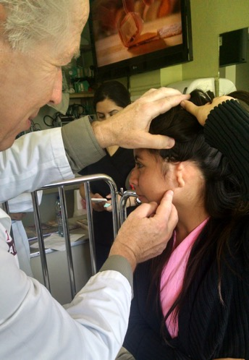
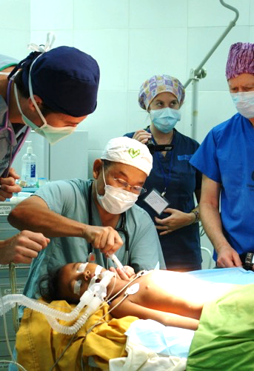
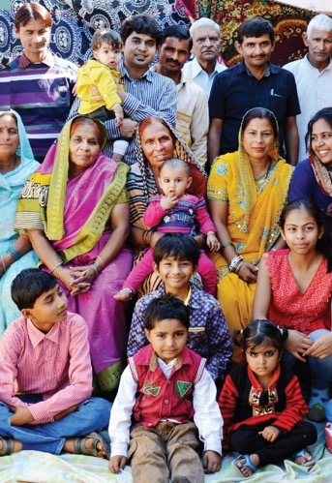
Our
Story
TREAT
TRAIN
TRANSFORM

Slide 2
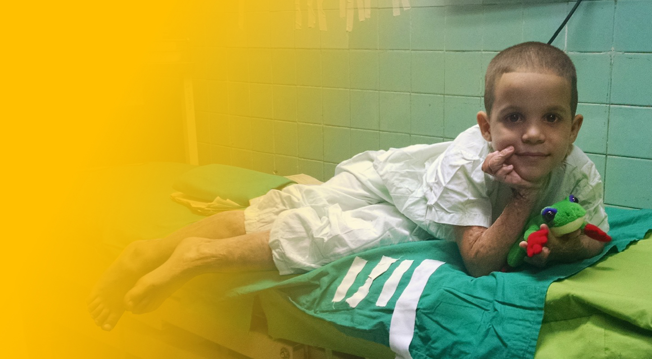
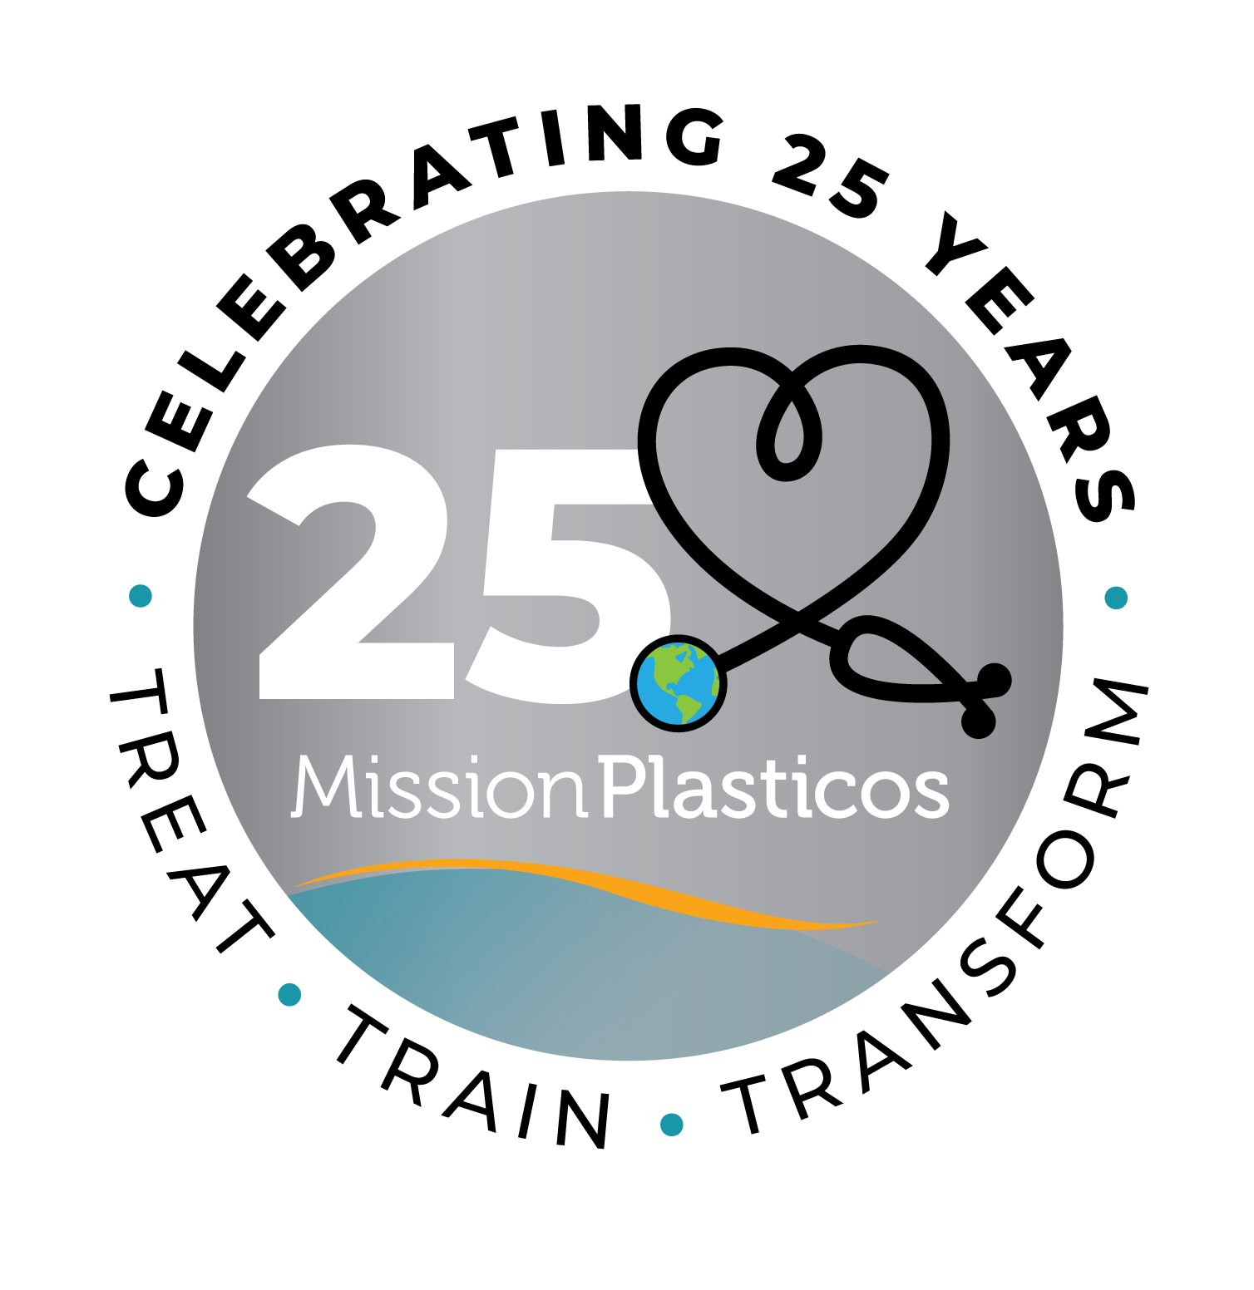
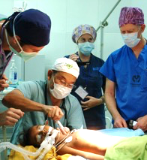
Our Mission
Founded in 1999 by renowned plastic surgeon Dr. Larry Nichter, Mission Plasticos is a 501c3 non-profit organization dedicated to providing reconstructive surgical care to those in need, and to generate sustainable outcomes through medical team training, public education and research.
Treat. Train. Transform.

Slide 3
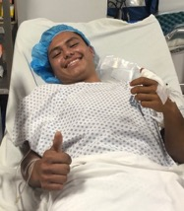
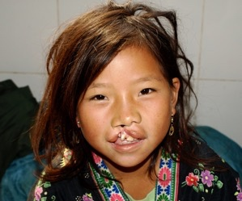
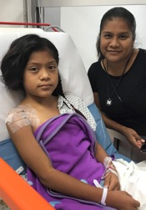
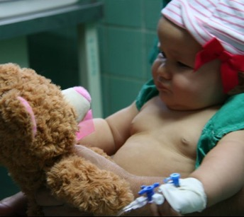
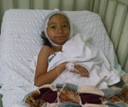
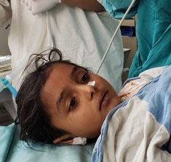
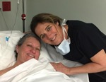
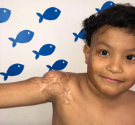
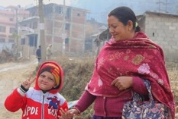
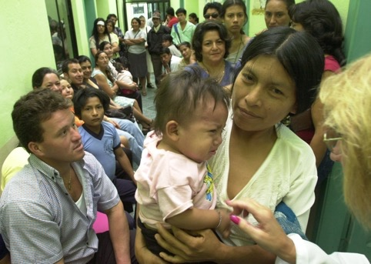
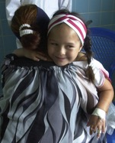
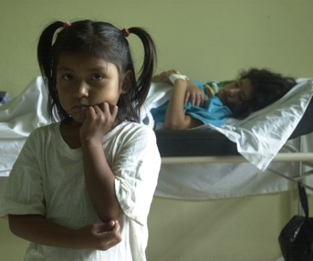
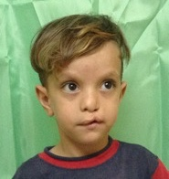
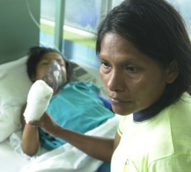
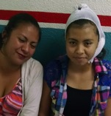
Who We Help
We focus on those in need of reconstructive surgery in medically underserved communities, both locally and globally.

Slide 4
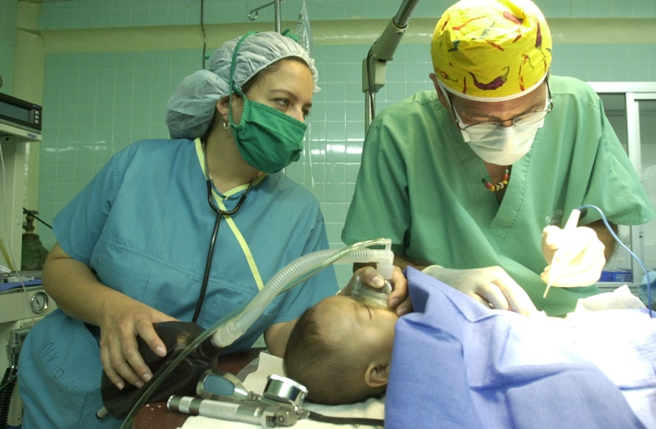
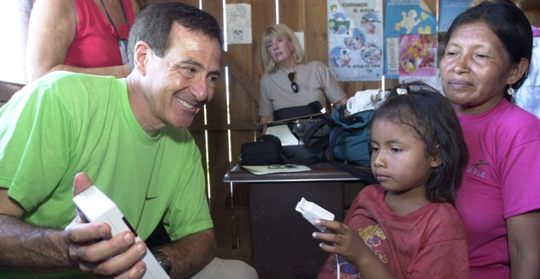
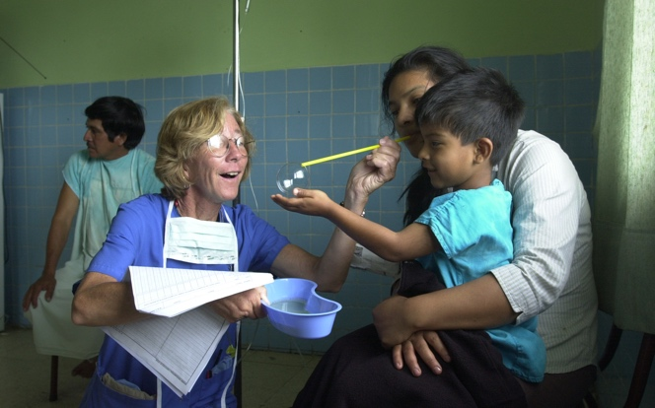
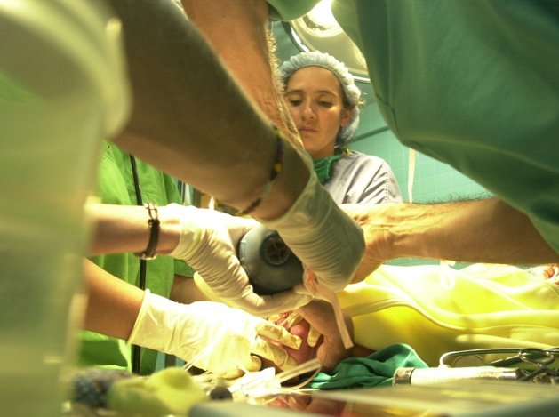
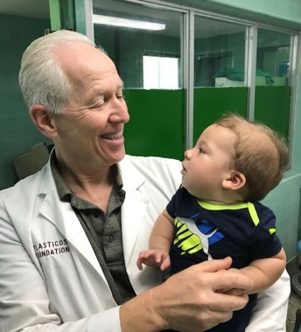
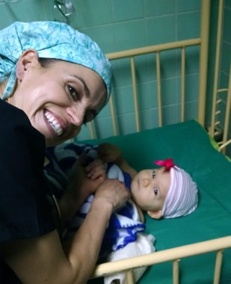
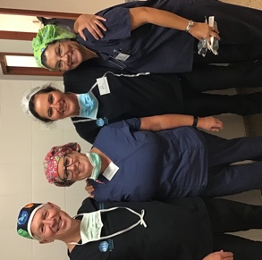
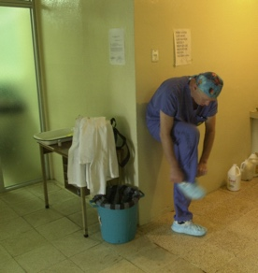
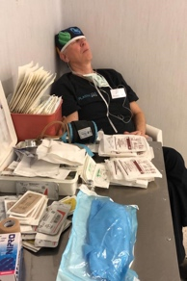
How We Make It Happen
Our volunteer team of leading surgeons and medical professionals dedicate their time, talent, and care to transform lives globally by providing reconstructive surgery, training local medical professionals, and supporting ongoing research focused on improving standards of care.

Slide 5
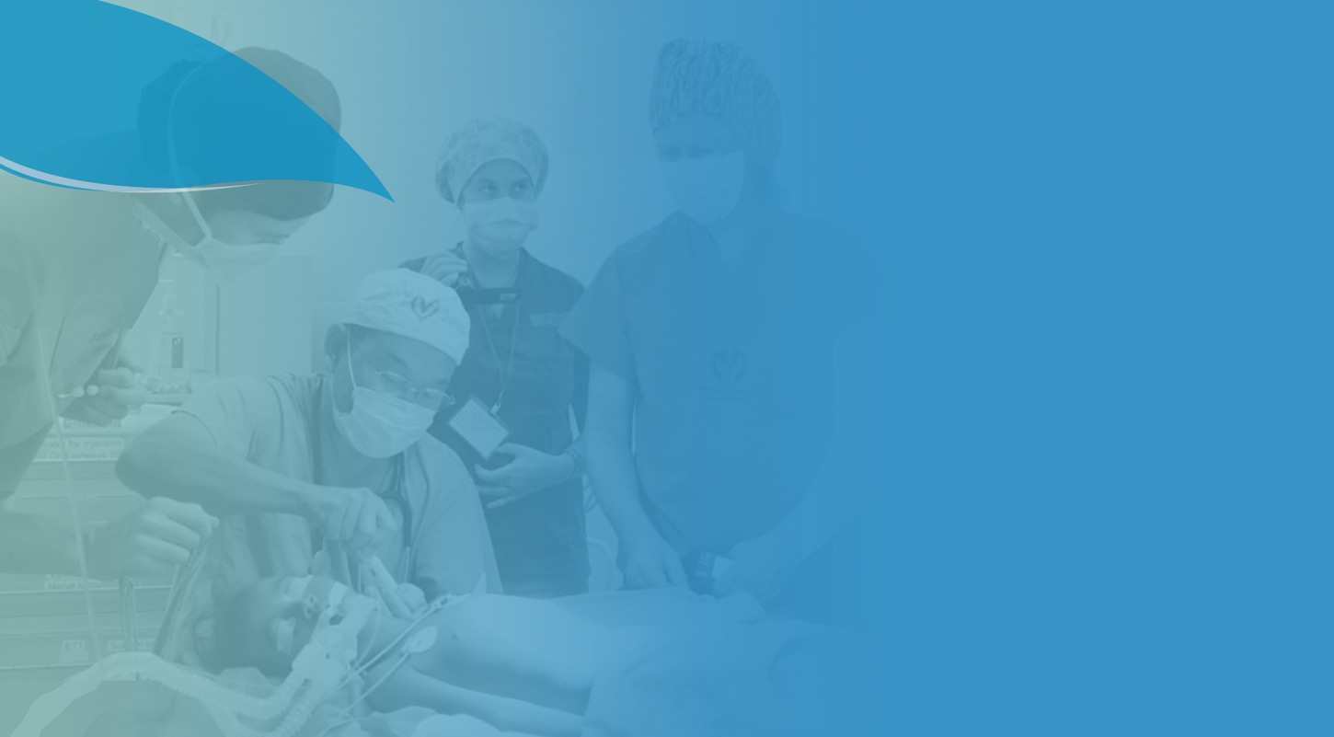
What We Treat
Acute
Burns
Burn Scar Contractures
Cleft Lip and Palate
Complex traumatic injuries, acute burns, and disfigurement as a result of burn scar contractures, cancer and congenital deformities.
Hand Deformities and Injuries
Ear Deformities
Post-Mastectomy
Breast
Reconstruction

Slide 6
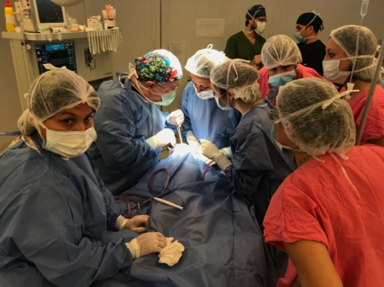
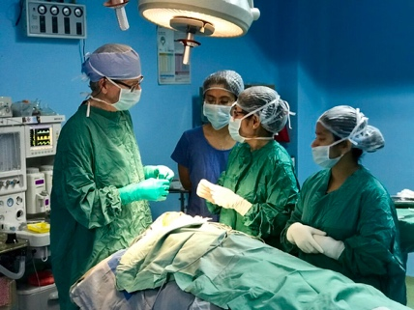
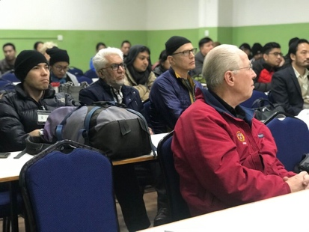
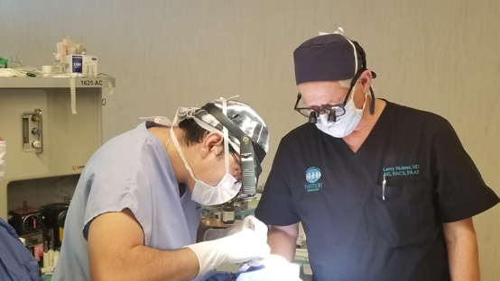
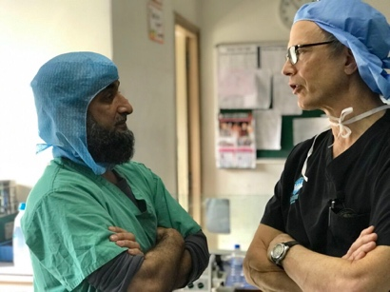
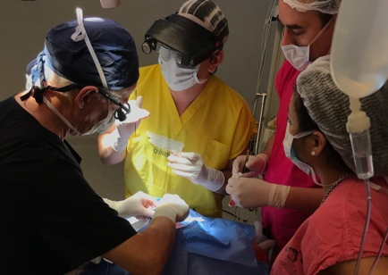
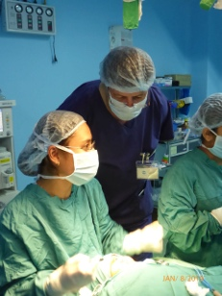
How We Train
Mission Plasticos is equipping and empowering local health care teams to transform lives In their local communities, ensuring sustainable and optimal outcomes.
We offer:
Hands-on advanced surgical training
Education on best practices
Follow-up visits
Annual oversight and prevention strategies

Slide 7
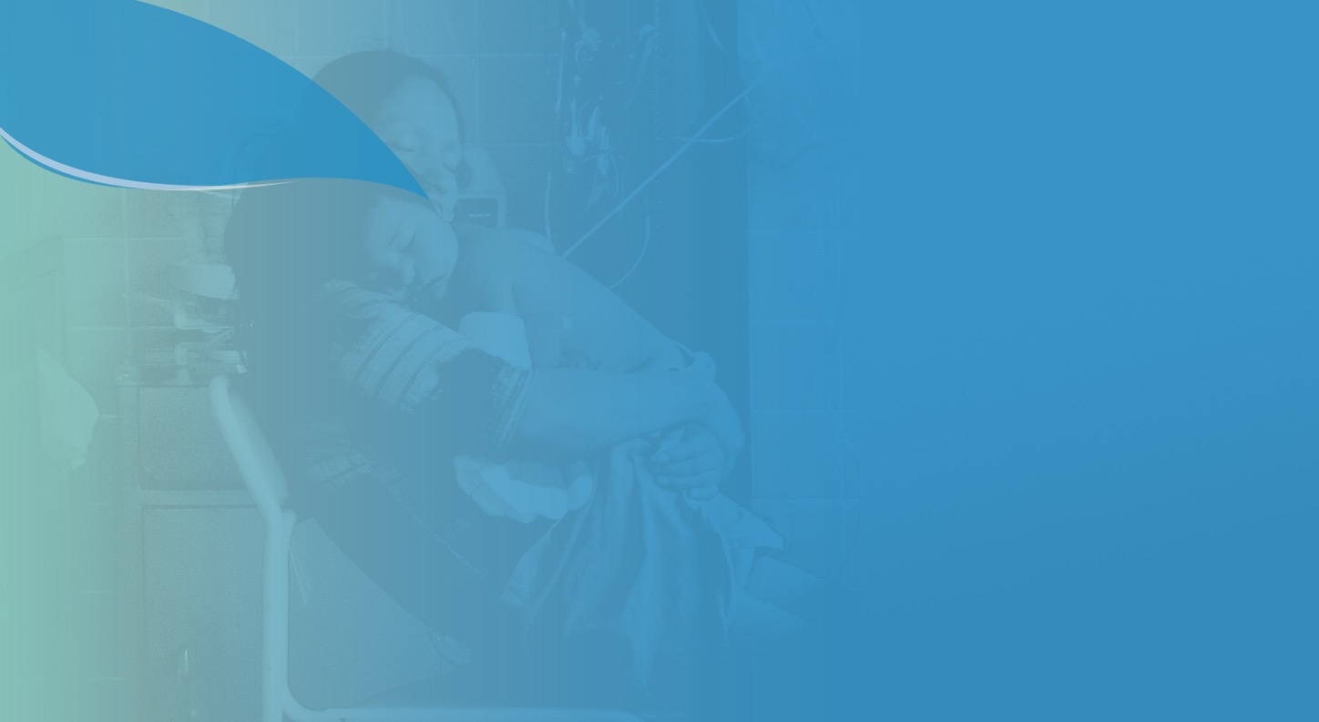
100+
MISSIONS
COMPLETED
650
~
MEDICAL
VOLUNTEERS
5,000+
DOCTORS
TRAINED
The Plasticos Effect:
A Legacy of
Transformation
16,000+
PATIENTS
TREATED
COUNTLESS LIVES AND
COMMUNITIES TRANSFORMED

Slide 8
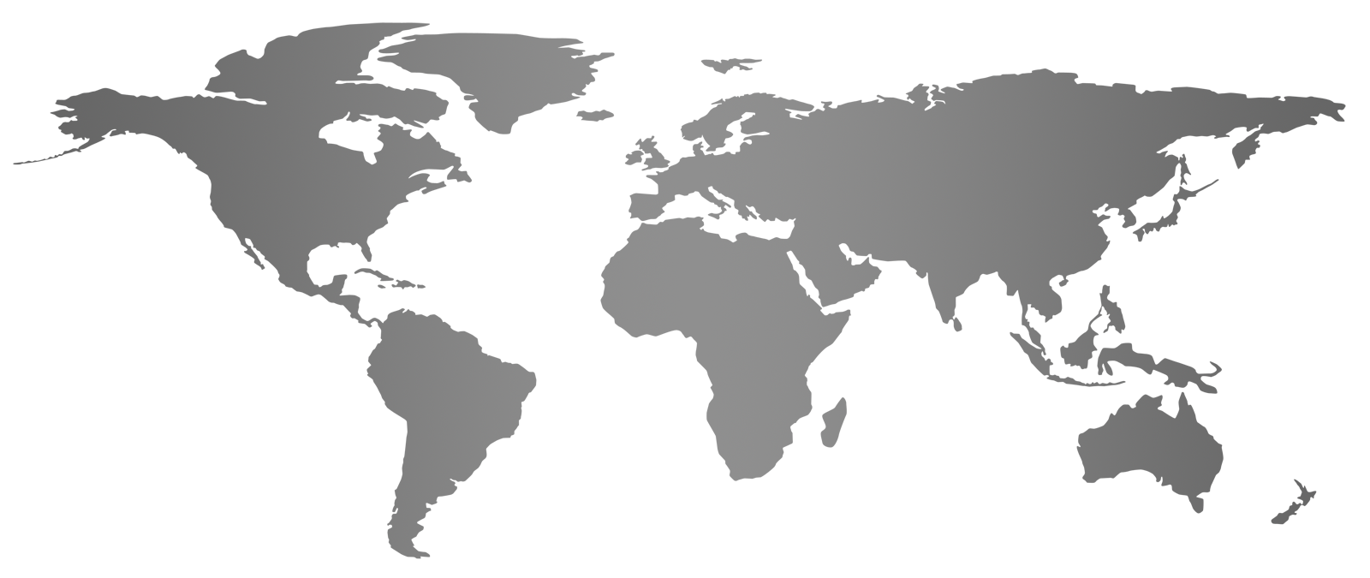
Our Global Reach
We partner with hospitals and doctors in the United States, and around the globe to treat, train and transform lives. We continue to expand our footprint based on the most pressing needs and, to date, have conducted missions in Argentina, Armenia, Afghanistan, Bolivia, Brazil, Cambodia, Cuba, Ecuador, Guatemala, India, Laos, Mexico, Nepal, Nicaragua, the United States, and Vietnam.

Slide 9
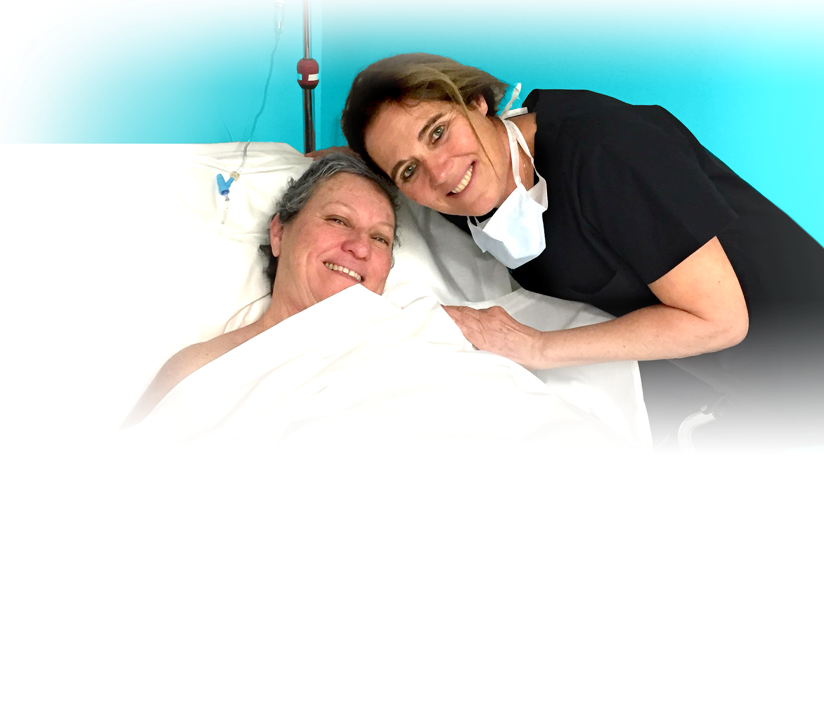
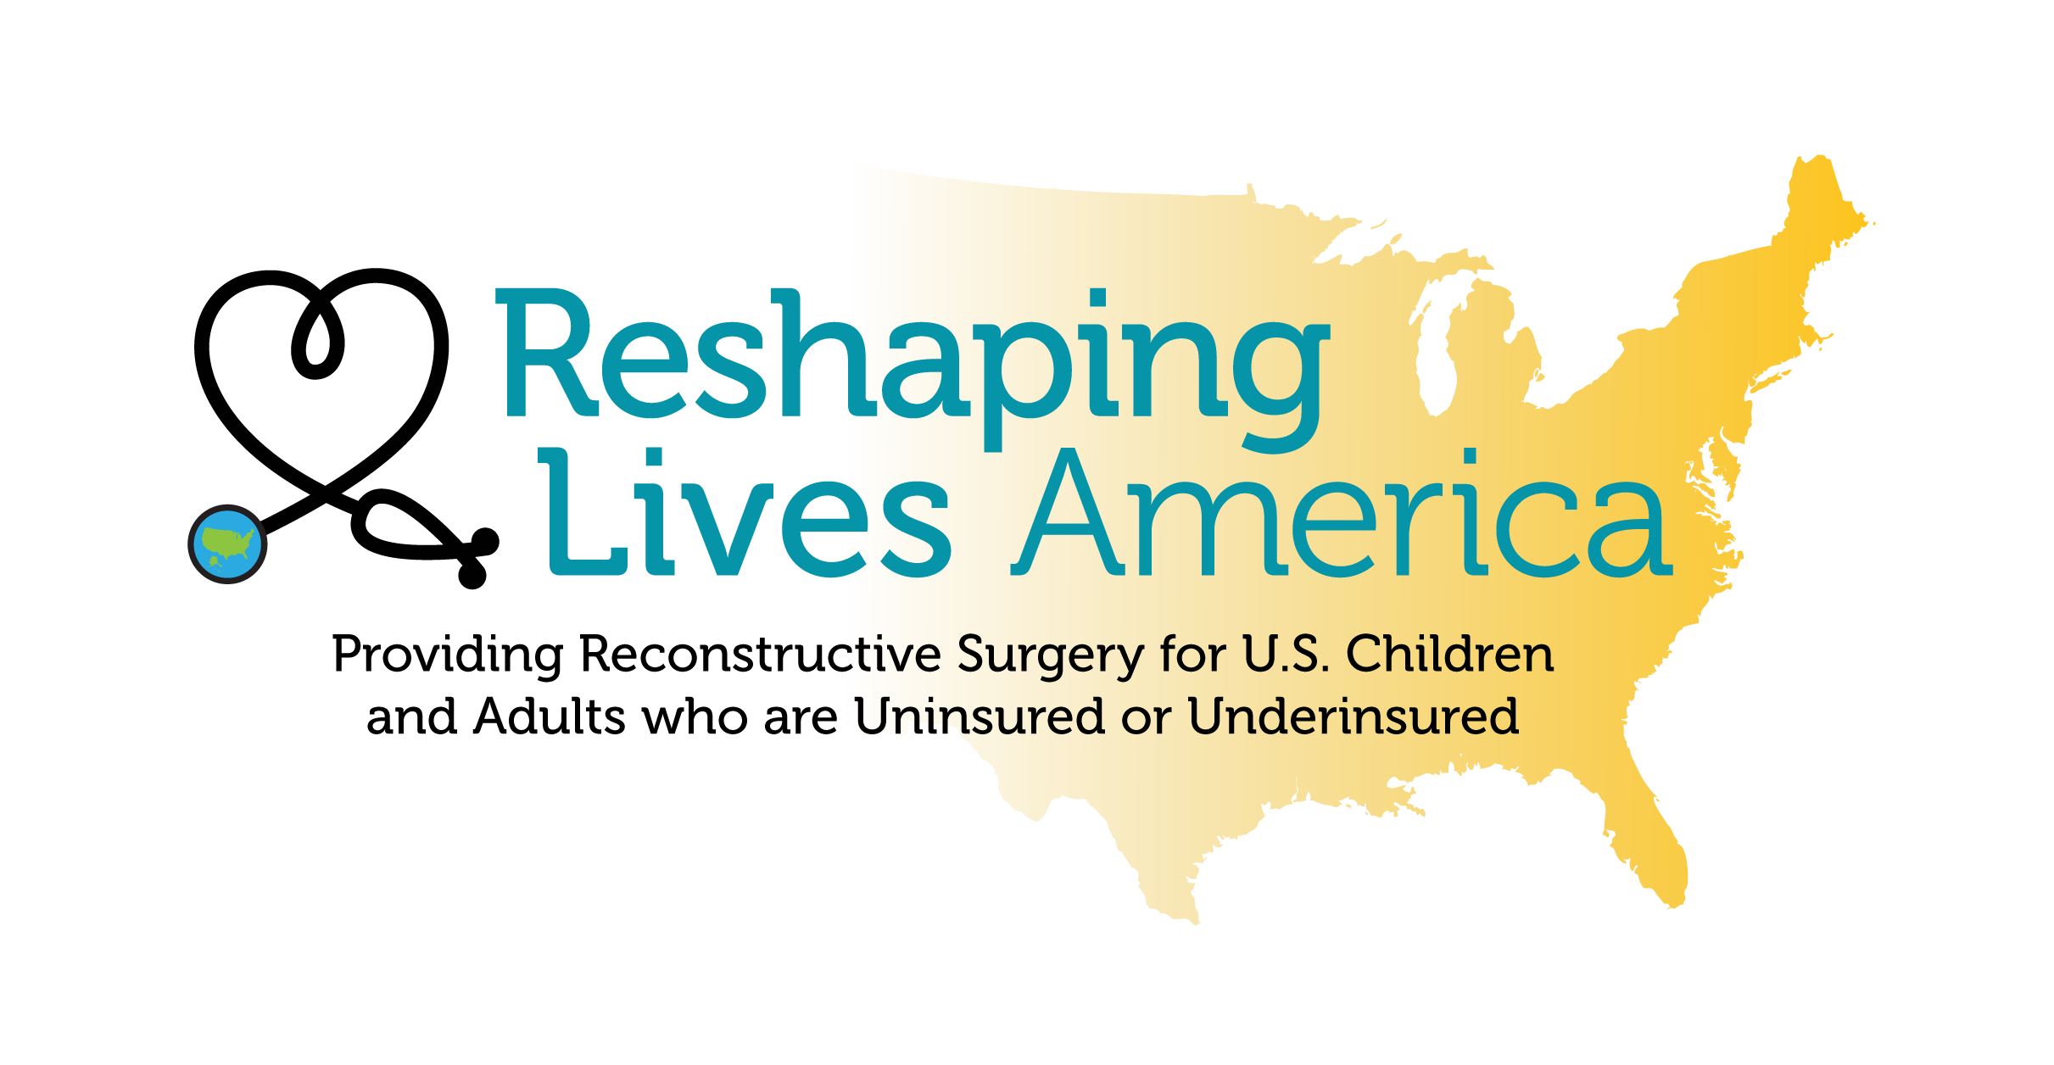
Kareen, cancer survivor and breast reconstruction patient, with Dr. Isabelle Schaison, Founder of Reshaping Lives California
Mission Plasticos’ domestic program Reshaping Lives America provides no-cost burn contracture surgery, post traumatic and congenital deformities, and other reconstructive surgical care to people living in poverty in the United States. It is based on our southern California pilot program Reshaping Lives California, which has already helped over 1,000 local patients in need.
Reshaping Lives America’s national breast reconstruction program, Reshaping Lives: Full Circle, provides breast reconstruction surgery to post-mastectomy women who are uninsured or underinsured. All surgeries are performed by board-certified volunteer surgeons.

Slide 10
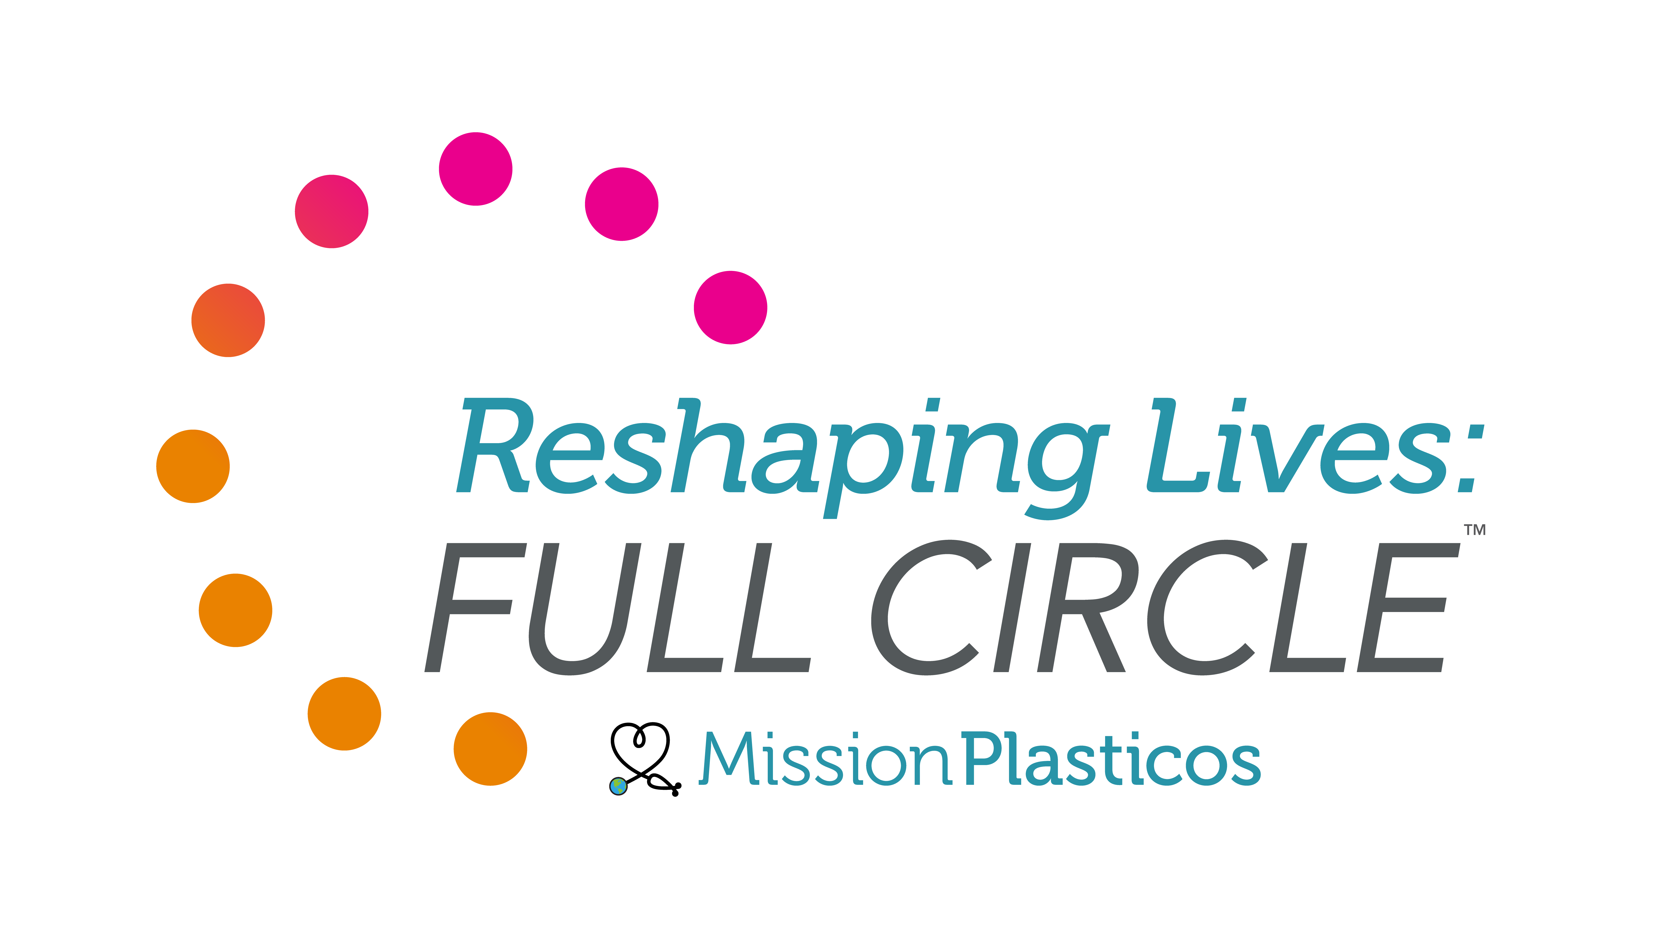
60%
Reshaping Lives: Full Circle is the first large-scale nationwide program providing no-cost breast reconstruction surgery for post-mastectomy women in the U.S. who are uninsured or underinsured.
Mission Plasticos provides this care using volunteer board-certified plastic surgeons across the country who are experts in breast reconstruction. Program partners MTF biologics provide tissue for each patient, and Restorative Ink Specialists provides 3D nipple tattooing. Further generous support for the program comes from MiraDry, AnaOno, and AlumierMD. Once patients are identified at the local level, Mission Plasticos thoroughly vets each and completes their full journey of care.
Part of Mission Plasticos’ broader Reshaping Lives America program, Reshaping Lives: Full Circle is based on the success of Mission Plasticos’ global work over the last 25 years and their pioneering domestic work in California since 2016.
of U.S. women with breast cancer who live below the poverty line are inadequately insured and may not have access to breast reconstructive surgery¹ despite reconstruction being considered the standard of care in breast cancer recovery².
Every woman deserves
A full journey of care
regardless of her economic situation.
1. Gorey, K. M., Richter, N. L., Luginaah, I. N., Hamm, C., Holowaty, E. J., Zou, G., & Balagurusamy, M. K. (2015). Breast cancer among women living in poverty: Better care in Canada than in the United States. Social Work Research, 39(2), 107–118. https://doi.org/10.1093/swr/svv006. 2. “Women’s Health and Cancer Rights Act (Whcra).” CMS, www.cms.gov/CCIIO/Programs-and-Initiatives/Other-Insurance-Protections/whcra_factsheet.

Slide 11
Surgeon Recruitment
Contact us if you are a board-certified surgeon interested in volunteering for our life-changing program providing no-cost breast reconstructive surgery to post-mastectomy women in the U.S. living in poverty.
SURGEON COMMITMENT
By signing up for the Reshaping Lives: Full Circle program, surgeons are committing to performing at least one Reshaping Lives: Full Circle breast reconstruction surgery during the 2024 calendar year.
Reshaping Lives: Full Circle will help identify patients in need in the surgeon’s area and supply implants and expanders plus MTF Biologics acellular dermal matrix (SDM) for each surgery, free of charge.
All other costs including staff and surgery center fees will be arranged and covered at the surgeon’s expense.
All volunteer work is tax-deductible. Mission Plasticos will process the paperwork and supply a letter for the surgeon’s in-kind gift.
RESHAPING LIVES: FULL CIRCLE APPRECIATION
We will promote each surgeon’s program involvement with a listing on our dedicated surgeons page on the Reshaping Lives: Full Circle website.
The surgeon and practice will also be highlighted in the Featured Surgeon section on the home page and promoted through social media
Surgeons will also receive a commemorative Reshaping Lives: Full Circle scrub cap and a special program badge to add to their practice website.
Most importantly, surgeons gain the opportunity to differentiate themselves and their practice by helping those in need and giving back to their community.

Slide 12
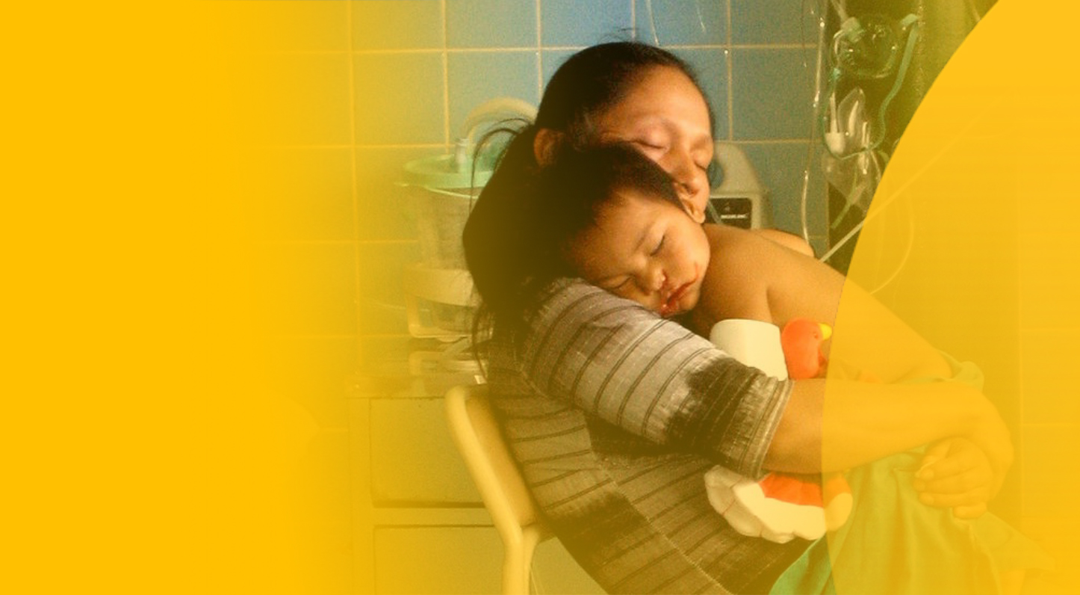
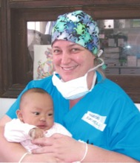
Global Impact
Mission Plasticos’ volunteer teams travel year-round to poverty-stricken regions to perform life-changing reconstructive surgeries and training that empower health care professionals around the globe.
“I was told that this would be a life changing experience, but I was unable to grasp the reality of the situation prior to arrival. Cold hallways, hopeful faces, sad tears, gentle touches, and life and death surrounded me. The patients were genuinely thankful for the care they were receiving, and the local team continued to do their very best with all odds against them. Together, we can overcome challenges and provide hope and support for those who need it most, whether home or abroad.”
— Olyvia Weston, Global Volunteer

Slide 13
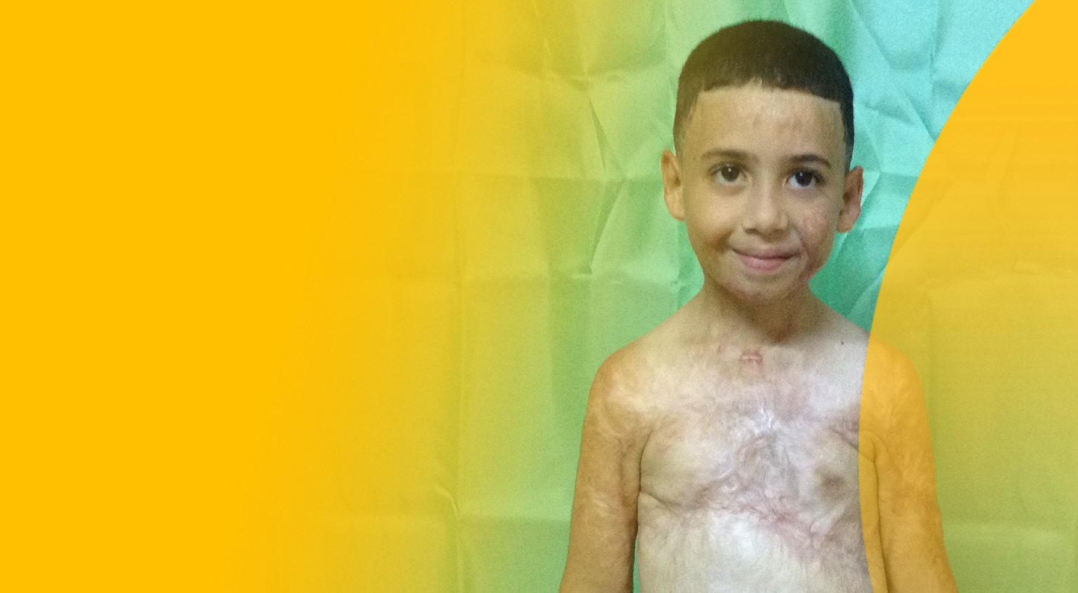
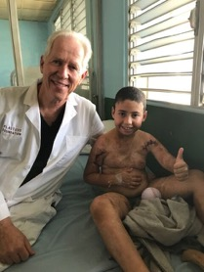
Transforming lives via our Acute Burn Program
Mission Plasticos has made history for being the first NPO to train others in optimal burn management in developing countries.
The Mission Plasticos team is proud to take on this important mission given the great need in medically underserved communities.
“In the presence of patients with severe burns in a hospital with very limited resources, the heroes are the brave doctors and warrior nurses. From surgeons and anesthesiologists I learned that indomitable character is the most valuable way to deal with this catastrophe, in performing life-saving surgeries typical of war situations.”
— Dr. Gary Fudem
Notes:
The Mission Plasticos team provides advanced acute burn care and training – including hands-on surgical experience, lectures and follow-up visits – to burn surgeons, plastic surgeons, anesthesiologists, respiratory therapists, occupational therapists, and critical care nurses across the globe.
Comprehensive burn treatment and education program at Kirtipur Hospital in Kathmandu, Nepal multi-pronged approach:
Determine major causes of burn injuries in Nepal and recommend solutions
Introduce advanced surgical techniques for the acute burn treatment that prevent contractures, disfigurement and disability
Educate regarding the importance of nutrition, hygiene, physical therapy and psychological therapy for survival and optimal healing and rehabilitation on all levels
Provide annual oversight and training visits to promote implementation of best practices and needs assessment going forward.
Conduct ongoing analysis of burn prevention strategies

Slide 14
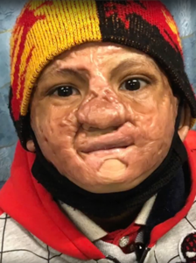
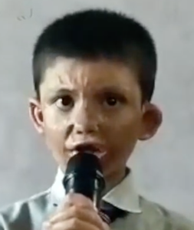
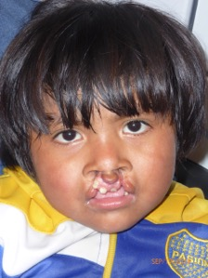
Abiskar
Nepal
Acute Burns
Personal
Impact
BEFORE
AFTER
Jose Victor
Argentina
Cleft Lip and Palate
BEFORE
AFTER

Slide 15
How You Can Help
Requests for assistance from global partners and local agencies have increased in volume and urgency.
Mission Plasticos is 100% privately funded and our ability to transform lives is directly proportionate to donations received.

Slide 16
Every Donation Matters
$50,000
Treat 100+ patients
Train 20+ doctors and nurses through hands-on experiences and symposia
Transform lives and a community
$10,000
Treat 10+ patients
Train 10+ doctors and nurses through hands-on experiences
Transform lives
$25,000
Treat 20+ patients
Train 10+ doctors and nurses through hands-on experiences and symposia
Transform lives
$5,000
Treat 5+ patients
Train 5+ doctors and nurses through hands-on experiences
Transform lives

Slide 17
Council of Trustees
Joe Yaccarino
Reshaping Lives America Council of Trustees Chair, MTF Biologics President and Chief Executive Officer
Robert Catlin
Reshaping Lives America Council of Trustees Member, CEO, MiraDry
Sientra, a medical aesthetics company uniquely focused on plastic surgery, is the founding trustee of Reshaping Lives America. MTF Biologics President and Chief Executive Officer Joe Yaccarino serves as the new Chairman of the Reshaping Lives America Council of Trustees, the funding arm of the program. The Council of Trustees provides Mission Plasticos with operational support and guidance on U.S. expansion and policy matters pertaining to providing access to reconstructive surgical care for U.S. patients in need.
Join the Reshaping Lives America Council of Trustees to help Mission Plasticos grow this amazing program into a nationwide movement.
N. Bill Aydin, MD, FACS
Reshaping Lives America Council of Trustees Member, Double Board-Certified Plastic Surgeon at Aydin Center for Plastic Surgery
Oliver Burckhardt
Reshaping Lives America Council of Trustees Member, Tiger Aesthetics Co-CEO
Natalie Do, DO., Pharm.D.
Reshaping Lives America Council of Trustees Member, Medical Director of Behavioral Health, CalOptima
Scott Madden
Reshaping Lives America Council of Trustees Member, Tiger Aesthetics Co-CEO

Slide 18
Board of Directors
Anne Andrews, JD
Board Chair
Andrews & Thornton, Managing Partner
Ben Crump
Board Member
Ben Crump Law President and Founder
Staff
Gregory R.D. Evans, MD, FACS
Board Member
Professor of Plastic Surgery and Biomedical Engineering, Founding Chair Department of Plastic Surgery, The Bruce F. Connell Endowed Chair in Plastic Surgery, The University of California, Irvine, Past President American Society Plastic Surgeons
Hans Keirstead, PhD
Immediate Past Board Chair
AIVITA Biomedical, Inc., Chief Executive Officer
Susan Williamson
Executive Director
Larry Nichter, MD, FACS, FAAP
Founder and Medical Director
Pacific Center Plastic Surgery Co-owner, BioSpa Medical Co-owner
Sarah Kelly-Kilgore
Board Member
Greenberg Gross LLP Administrative Partner, Los Angeles Office
Megan Seltzer
Director of Events & Community Outreach
Susan Williamson
Executive Director
Jarret Prussin
Board Member
Business Funding Group Chief Executive Officer
Adriana Murillo
Program Director
Michael French, CPA, ABV, CFE
Treasurer
Partner, JLK Rosenberger, LLP
Patricia Wilson
Board Member
Executive Vice President for JusticeCentral.tv, Executive Producer (PGA), Showrunner at Entertainment Studios

Slide 19
Advisory Council
Business Advisory Council
Fairyal Day
Med Talent Finder Manager Director
Dana Donofree
Founder & CEO, AnaOno
Scott Flowers
Director of Sales & Marketing, Sylke, Inc.
Gloria M Janata, JD
TogoRun, President & CEO
Don Maree
President of AlumierMD USA & President of the Alumier Foundation USA
Tom Seery
Real Self, CEO
Medical Advisory Council
John H. Barker, MD Friedrichsheim Foundation Professor of Experimental Trauma & Orthopedic surgery Director, Frankfurt Initiative for Regenerative Medicine, J.W. Goethe-Universität Frankfurt, Germany
Juan Jose Chavez, MD FACS Cabo San Lucas, Mexico
Ernesto Cofiño, MD Angeles de la Tierra President, Guatemala City, Guatemala
Gary Fudem, MD, FACS Professor of Surgery, Plastic Surgery and Burns, University of Massachusetts and University of Washington
Holly Hurless, MSN, RN Director of Nursing, Mission Plasticos
Karen Leong, MD Reshaping Lives America Lead Surgeon
Jeanine McTasney CPCP, FAAM Clinical Instructor, Master Tattooist & Founder of Restorative Ink Specialist
Harsh Patel, MD UCLA Plastic Surgery
Isabelle Schaison, PhD Reshaping Lives California Founder
Sam Sharar, MD Mission Plasticos Anesthesia Critical Care and ICU Professor
James. P. Watson, MD, FACS UCLA Health
Stephen Westerhout, MD Director of Anesthesiology
Board Emeritus
Scott Burell
AIVITA Biomedical, Inc., Chief Financial Officer and Corporate Secretary
Robert Burns, MD, PhD General and Vascular Surgeon, Emeritus Chair
Ruth Ann Burns Friends of Plasticos, Chair
Tim Glassett, JD General Counsel
Jed H. Horowitz, MD, FACS Pacific Center Plastic Surgery Co-owner & BioSpa Medical Co-owner
Rachel Russell Hoag Hospital, Cardiothoracic Surgery
Philippe Schaison Soltego, CEO
Sol Khazani U.S. Auto Parts Network, Inc., Co-founder, American Condenser, Inc., Co-founder, Kool Vue, Founder
Caroline Van Hove Revelle Aesthetics, President, Chief Executive Officer
Nella Webster O’Grady Ocean Heights Advisors, Managing Director

Slide 20
Thank You!
Mission Plasticos, a California non-profit corporation. 8502 E. Chapman Ave. #447, Orange, CA 92869 www.missionplasticos.org
Plasticos Foundation is a tax-exempt 501(c)(3) organization. Tax ID#: 33-0831358.

